Slide 1
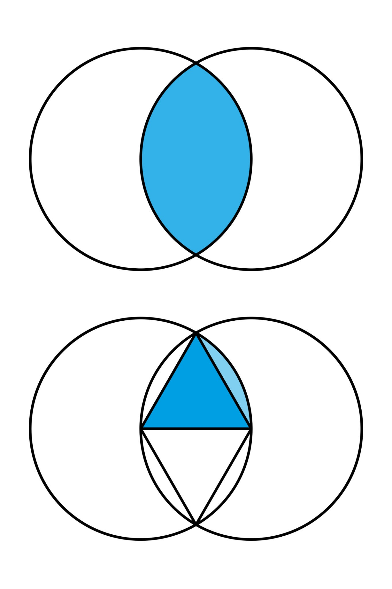

Hierarchical Threshold Cryptography
A System for Enforced Cross-Tier Collaboration
By: Jack Merritt

Slide 2
The Mathematical Problem
How can we design a system that:
-Mathematically enforces collaboration across organizational levels?
-Prevents any single group from acting unilaterally?
-Preserves hierarchical importance?
Solution: A weighted threshold cryptographic scheme

Slide 3
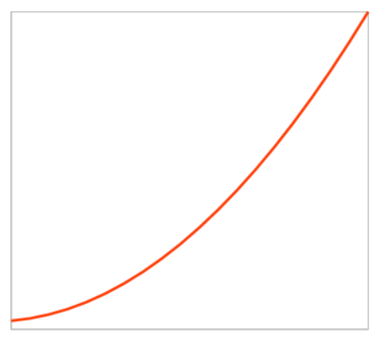
System Overview at a Glance
Hierarchical Structure: Tiers arranged from t₁ (top) to tₙ (bottom)
Member Distribution: Quadratic growth (i² members in tier i)
Threshold Requirement: 100 units of "cryptographic weight" needed
Weight Assignment: Higher tiers have more weight per member
Core Result: No single tier can act alone; cross-tier collaboration required

Slide 4
Core Mathematical Concepts
Threshold Function: T(k) = 100
-System requires ≥ 100 "weight units" to decrypt
Quadratic Growth Function: m(i) = i²
-Defines member count per tier
Weight Distribution Function: w(i) = {...}
-Assigns cryptographic "weight" per member
Collaboration Inequality: Σ(mₓ × w(x)) ≥ 100
-Mathematical condition for successful decryption

Slide 5
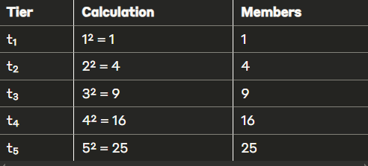
Tier Structure: Quadratic Growth
The function m(i) = i² determines the number of members in each tier:
Why quadratic? Creates balanced power distribution

Slide 6
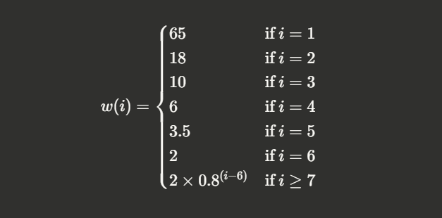
Weight Distribution: Mathematical Definition
The weight function w(i) is defined piecewise:

Slide 7
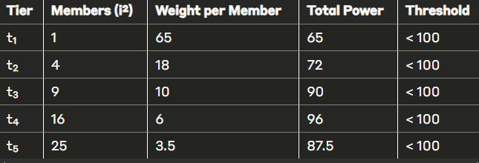
Tier Power Analysis
P(i) = m(i) × w(i) = i² × w(i)

Slide 8
Mathematical Proof: No Single-Tier Decryption
No tier alone can decrypt the message, leading to forced collaboration
t₁: P(1) = 1 × 65 = 65 < 100
t₂: P(2) = 4 × 18 = 72 < 100
t₃: P(3) = 9 × 10 = 90 < 100
t₄: P(4) = 16 × 6 = 96 < 100
t₅: P(5) = 25 × 3.5 = 87.5 < 100
t₆: P(6) = 36 × 2 = 72 < 100

Slide 9
Proof for tiers ≥ 7
For i ≥ 7: P(i) = i² × 2 × 0.8^(i-6)
For i = 7: P(7) = 49 × 2 × 0.8 = 78.4 < 100
As i increases beyond 7, the exponential decay (0.8^(i-6)) outpaces quadratic growth (i²)
This means P(i) decreases for i > 7
Therefore, no tier i ≥ 7 can reach the threshold independently

Slide 10
For any collaboration across tiers, the total power is:
P_total = ∑(c_i × w(i))
c_i = count of members from tier i participating
w(i) = weight per member in tier i
Decryption succeeds when:
P_total ≥ 100

Slide 11
Viable Collaboration Examples
Example 1: High-tier focused P_total = (1 × 65) + (2 × 18) = 65 + 36 = 101 > 100
-1 member from t₁
-2 members from t₂
Example 2: Mid-tier collaboration P_total = (2 × 18) + (7 × 10) = 36 + 70 = 106 > 100
-2 members from t₂
-7 members from t₃

Slide 12
Mathematical Properties of the System
Monotonically Decreasing Weights: w(i) > w(i+1) for all i
-Higher tiers will always have more cryptographic power
Hierarchical Preservation: The ratio between consecutive tiers remains significant
w(t₁)/w(t₂) = 65/18 ≈ 3.6
w(t₂)/w(t₃) = 18/10 = 1.8
For i ≥ 7: w(t_i)/w(t_{i+1}) = 1/0.8 = 1.25 (constant)
Forced Collaboration:
The threshold k is set such that: max_i (i² × w(i)) < k < min_{i,j} (i² × w(i) + j² × w(j))

Slide 13
Geometric Interpretation
The system creates a multi-dimensional space where:
Each axis represents a tier
Points represent possible collaborations
The threshold defines a hyperplane H: ∑(x_i × w(i)) = 100
Valid collaborations lie in the half-space beyond this plane
The piecewise weight function creates interesting geometric properties
https://www.desmos.com/3d/mo7ki5zfjz

Slide 14
System in Practice: Key Properties
Balance of Power: Higher tiers have more individual influence but must still collaborate
Flexible Collaboration: Multiple valid collaboration patterns exist
Top-heavy: Fewer people from higher tiers
Bottom-heavy: Many people from lower tiers
Mixed: Representation across multiple tiers
Adaptability: System works with any organizational size
Mathematical Guarantees: Security properties are provably enforced

Slide 15
Applications in Computational Cryptography
Shamir's Secret Sharing: Extended with weighted participants
Traditional: k-of-n threshold
This system: Weighted threshold with hierarchical structure
Threshold Encryption: Requiring k-of-n participants with weights
Multi-Party Computation: Ensuring balanced input from hierarchical participants
Zero-Knowledge Proofs: Incorporating organizational structure into verification

Slide 16
Practical Applications
Corporate Governance: Secure decision-making across management layers
Multi-Party Computing: Enforced collaboration for sensitive operations
Secret Sharing: Distributed confidential information across organization
Access Control: Sophisticated permission management
Consensus Systems: Weighted voting mechanisms for blockchain/distributed systems

Slide 17
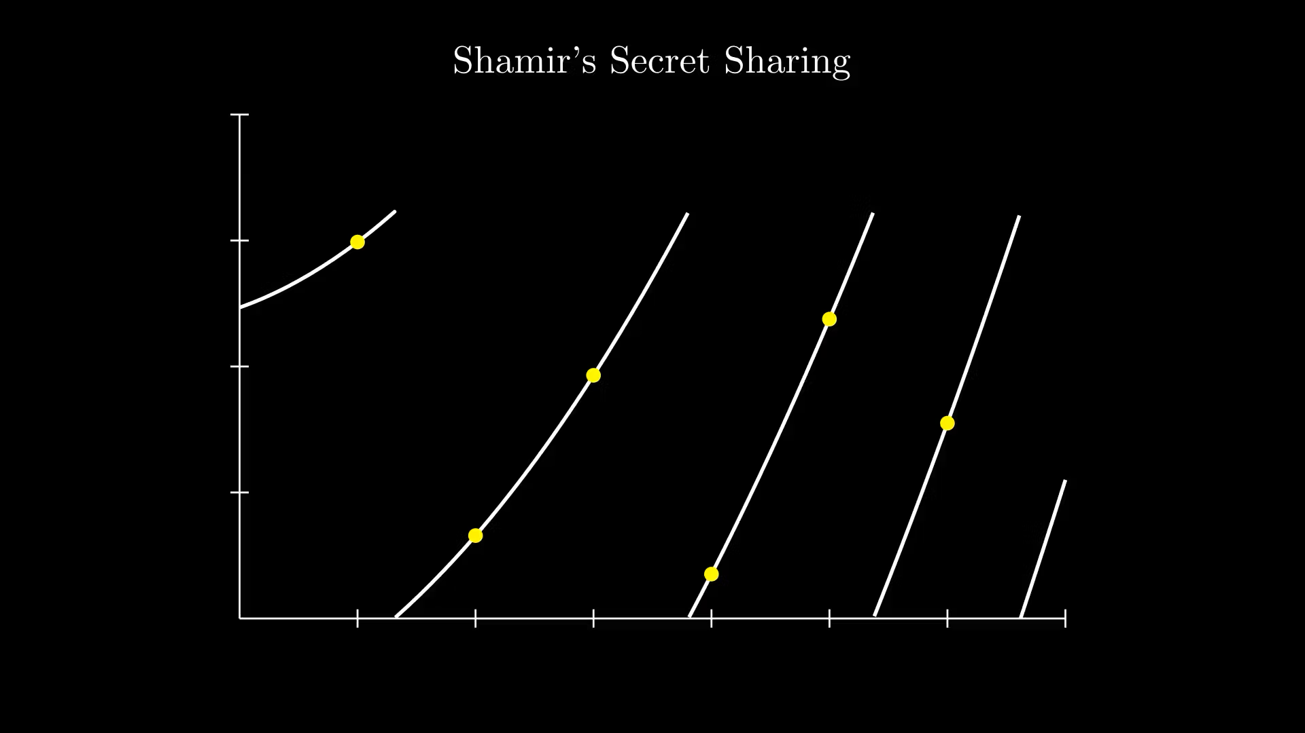
Future Directions
Dynamic Weight Functions: Adjusting weights based on system state
Threshold Optimization: Finding optimal k for specific organizational structures
Multi-Secret Systems: Extending to multiple thresholds for different secrets
Quantum Resistance: Adapting the scheme for post-quantum cryptography

Slide 18
Summary
Mathematical Foundation: Quadratic growth vs. exponential decay creates enforced collaboration
Hierarchical Respect: Weight distribution preserves organizational structure
Provable Properties: No single tier can act alone (proven mathematically)
Flexible Collaboration: Multiple valid patterns for reaching threshold
Practical Applications: Corporate governance, secure systems, access control

Slide 19
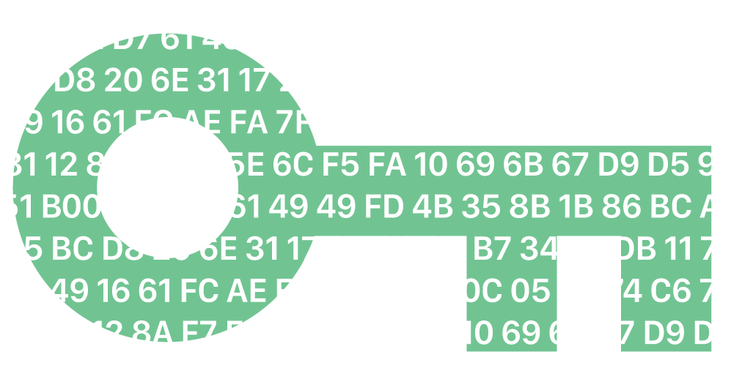
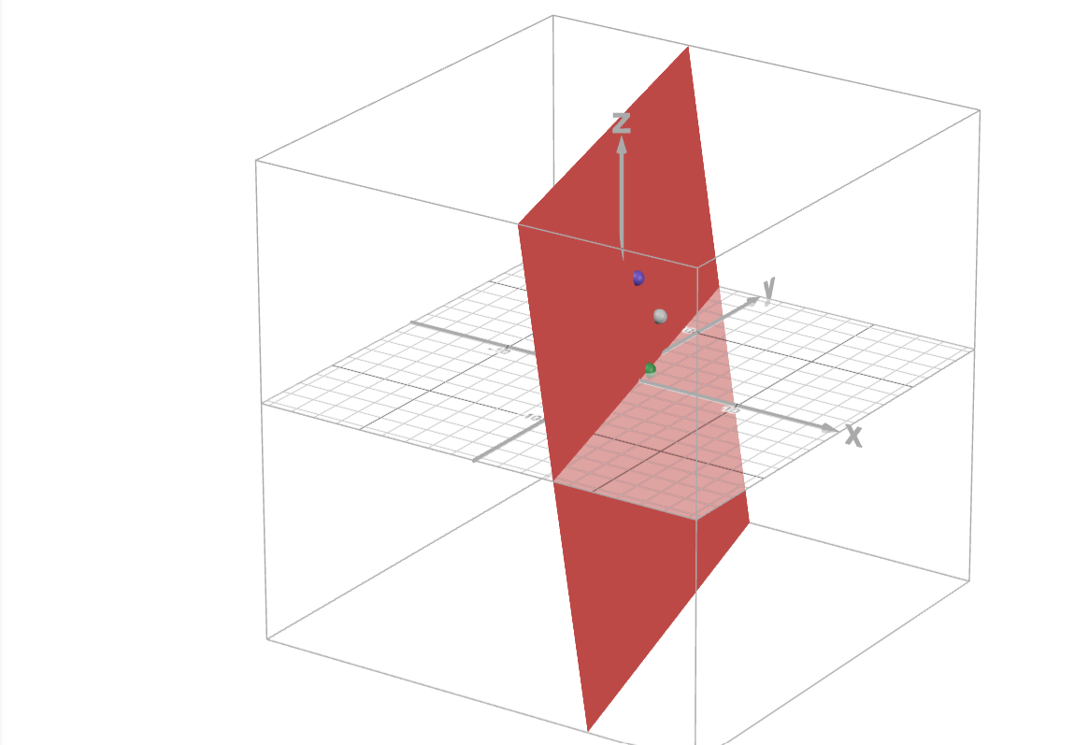
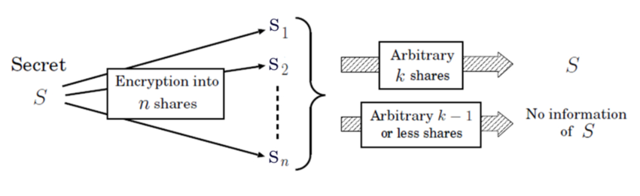
Thank you!
Find my contact information at: JackMerrittPortfolio.com

